Slide 1
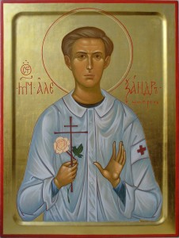
St. Alexander Schmorell, also known as St. Alexander of Munich 03/16.09.1917, Orenburg, Russia – 13.07.1943, Munich, Germany

Slide 2
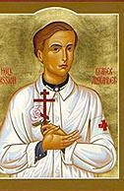
Martyred at the age of 25 due to his resistance to Nazism.
Medical student at the University of Munich.
Founding member of the anti-Nazi ‘White Rose’ movement: peaceful activists involved in distributing anti-Nazi leaflets.
Other core members: students Sophie and Hans Scholl, Christoph Probst , Willi Graf and a professor, Kurt Huber.
The movement was not a religious one, but its members were very much motivated by Christian beliefs and morality as their basis for resisting Nazism. They came from a variety of backgrounds: both Protestant and Catholic. Alexander was the only Orthodox among them.

Slide 3
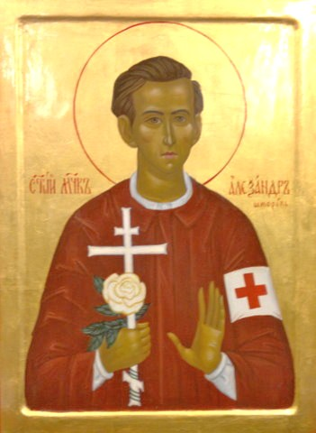
The ‘White Rose’ movement produced leaflets (they used Alexander’s typewriter) and sent them to random addresses all over Germany and Austria. Their aim was to motivate people to rise up against the Nazi regime.
Since the conquest of Poland, 300,000 Jews have been murdered in this country in the most bestial way ... The German people slumber on in dull, stupid sleep and encourage the fascist criminals. Each wants to be exonerated of guilt, each one continues on his way with the most placid, calm conscience. But he cannot be exonerated; he is guilty, guilty, guilty! 2nd leaflet
“Every word that comes from Hitler’s mouth is a lie. When he says peace, he means war, and when he blasphemously uses the name of the Almighty, he means the power of evil, the fallen angel, Satan…I ask you, you as a Christian wrestling for the preservation of your greatest treasure, whether you hesitate, whether you incline toward…procrastination in the hope that someone else will raise his arm in your defence? Has God not given you the strength, the will to fight? We must attack evil where it is strongest, and it is strongest in the power of Hitler”. 4th leaflet

Slide 4
St. Alexander’s father - ethnically German – a doctor - born in Russia and lived there most of his life.
His mother - Russian and the daughter of an Orthodox priest. Died of typhoid when he was only about a year old.
His father, although Lutheran Protestant, had allowed Alexander to be baptized in the Orthodox church. After his wife’s death, he hired a Russian nanny to look after Alexander, Feodosiya Lapschina; she was instrumental in keeping Alexander in the faith over the years.
His father remarried; new wife was also an ethnic German rooted in Russia, a Catholic, but both parents encouraged Alexander’s Orthodox upbringing, which continued after the family fled the Bolsheviks in 1921 with Feodosiya and settled in Munich. They had two other children who were brought up as Catholics.
Alexander was an able student and keen on sport. He chose to study medicine.
May – June 1942: The first four leaflets.
July 1942 – Served three months in the German military on the eastern front along with other members of the White Rose. Convinced that Germany would lose the war.
After returning to Munich, the fifth and sixth leaflets were produced. In February 1943, some of the White Rose members were caught. Gradually all the core members were executed by guillotine.
Alexander’s dual heritage: Nazi attitude to Slavs…service on the eastern front…
Bilingual…a bridge between his German comrades and the Russian culture.
"tall, lean, had tawny brown hair; there was an ironic gleam in his grey eyes and he had a light, casual way that made people around him want to smile."
Knowing the danger Alexander was in, in early 1943, his uncle burned most correspondence, notes and other documents relating to Alexander in an attempt to protect him.

Slide 5
Troparion (Tone 4)
Today a light adorns our glorious city,
having within it your holy relics, O Holy Martyr Alexander;
for which sake pray to Christ God,
that He deliver us from all tribulations,
for gathered together in love we celebrate your radiant memory,
imitating your bravery,
standing against the godless powers and enemies.
Kontakion (Tone 4)
From your mother you did inherit the love of Christ,
and through the love of your care-giver you were nourished in the fear of God, O all-glorious one,
to Whom you did give thyself, O all-honourable Alexander,
and you diligently pray with the angels.
Entreat on behalf of all who honour your memory a forgiveness of their sins.

Slide 6
Two schools and a number of streets are named after him in Germany.
"Now it shall be none other than this, and by the will of God, today I shall have my earthly life come to a close in order to go into another, which will never end and in which all of us will again meet. Let this future meeting be your comfort and your hope. Unfortunately, this blow will be harder for you than for me, because I go in the certainty, that in my deep conviction, I have served the truth..."
“I’m convinced that my life has to end now, early as it seems, because I have fulfilled my life’s mission. I wouldn’t know what else I have to do on this earth”.
Father Alexander (Andril) Lowtschy (later Archbishop Alexander), the priest at St. Nicholas Church (later renamed the Cathedral of the Holy New Martyrs and Confessors of Russia), where Alexander was a parishioner, was allowed to visit Alexander at Stadelheim prison to administer communion to him shortly before the execution took place.
One thing above all I commend to your hearts: Don’t forget God!

Slide 7
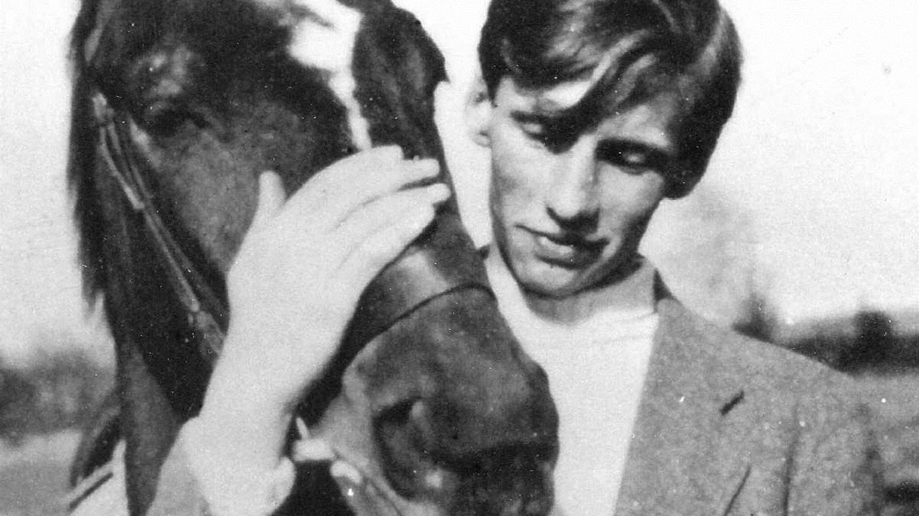
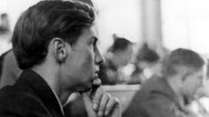
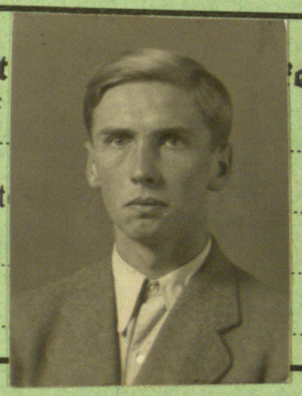
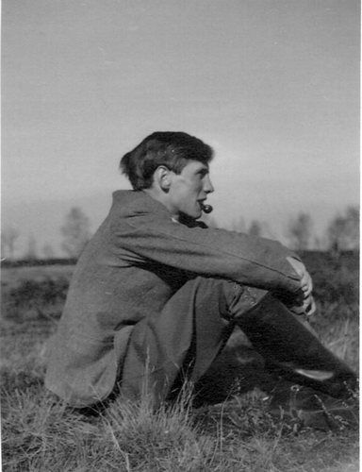
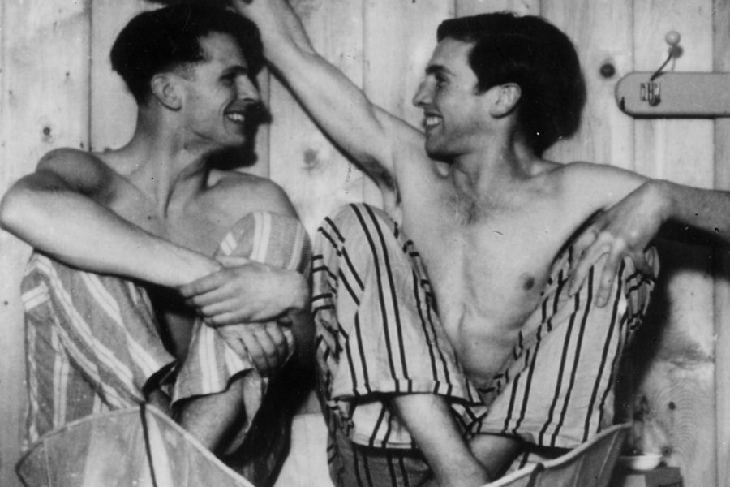
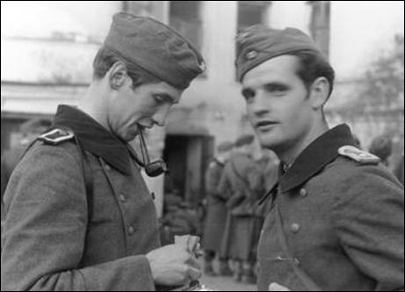
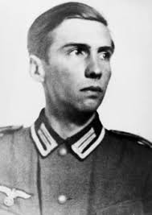
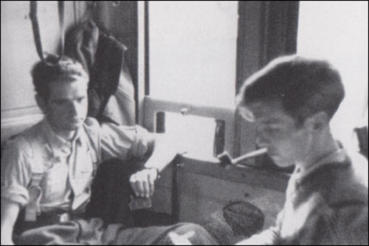
Existing photos of the saint

Slide 8
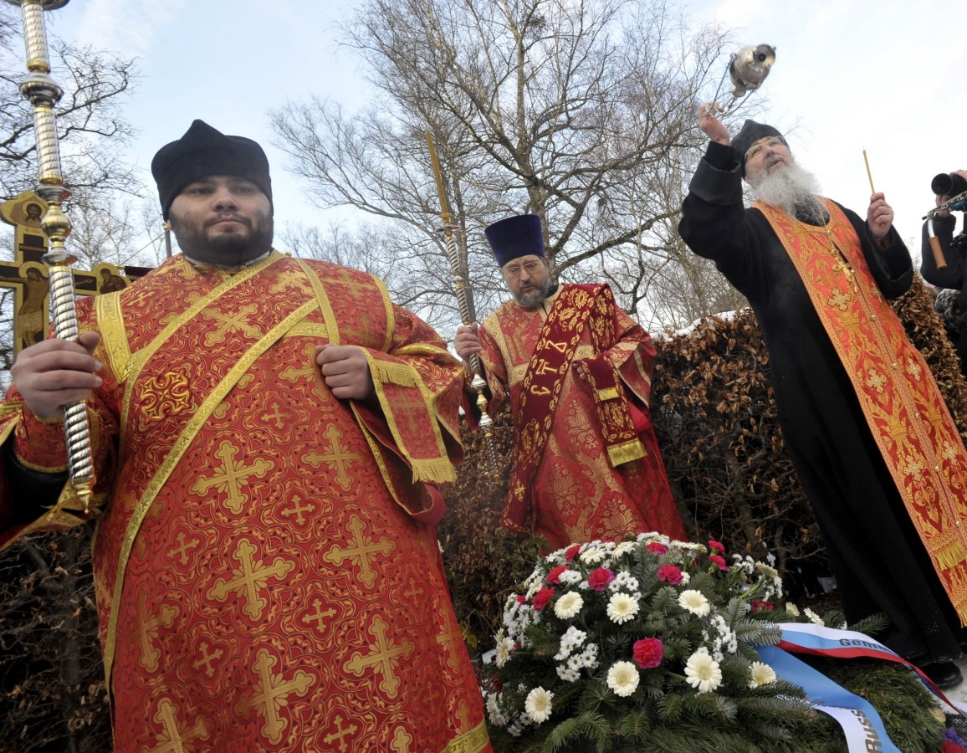
Glorified as a saint and passion-bearer by the Russian Orthodox Church outside Russia in Munich, 05.02.2012

